Slide 1
WELLCOME TO VACCINE BOOKING SYSTEM VAX HEAVEN.COM
CREATED BY : MR CAPTAIN TEAM

Slide 2
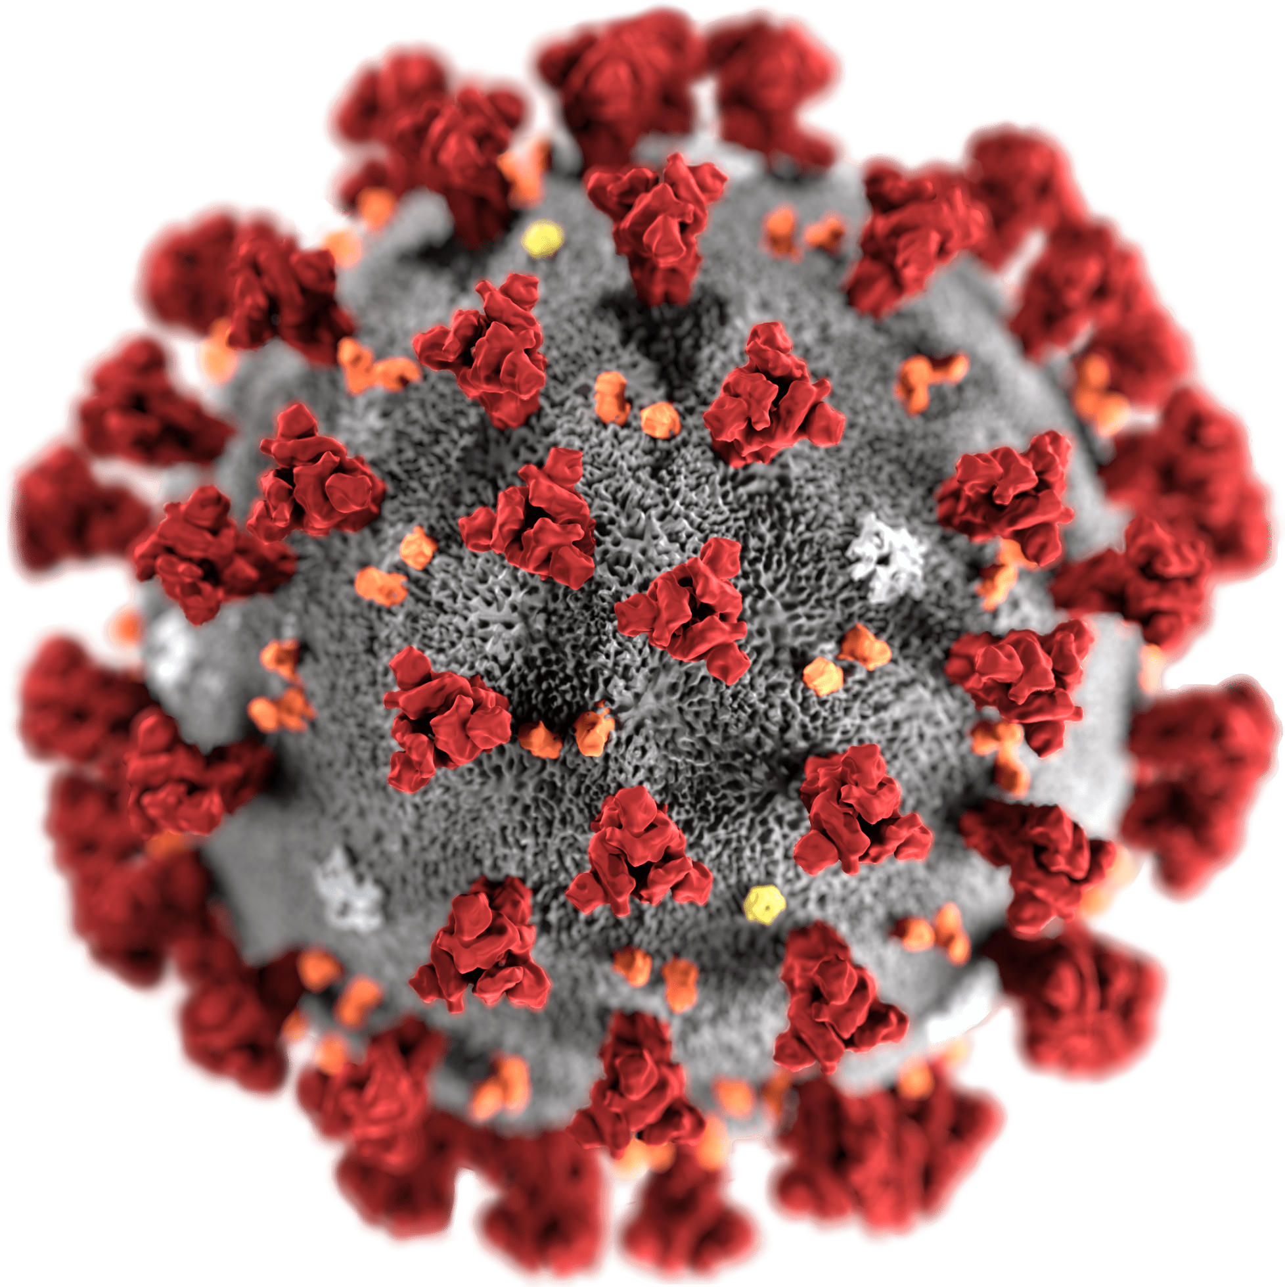
COVID-19
Coronavirus disease (COVID-19) is an infectious disease caused by the SARS-CoV-2 virus.
Most people infected with the virus will
experience mild to moderate respiratory
illness and recover without requiring special treatment.
However, some will become seriously ill and
require medical attention. Older people and
those with underlying medical conditions like cardiovascular disease, diabetes, chronic
respiratory disease, or cancer are more likely to develop serious illness. Anyone can get sick with COVID-19 and become seriously ill or die at any age.

Slide 3
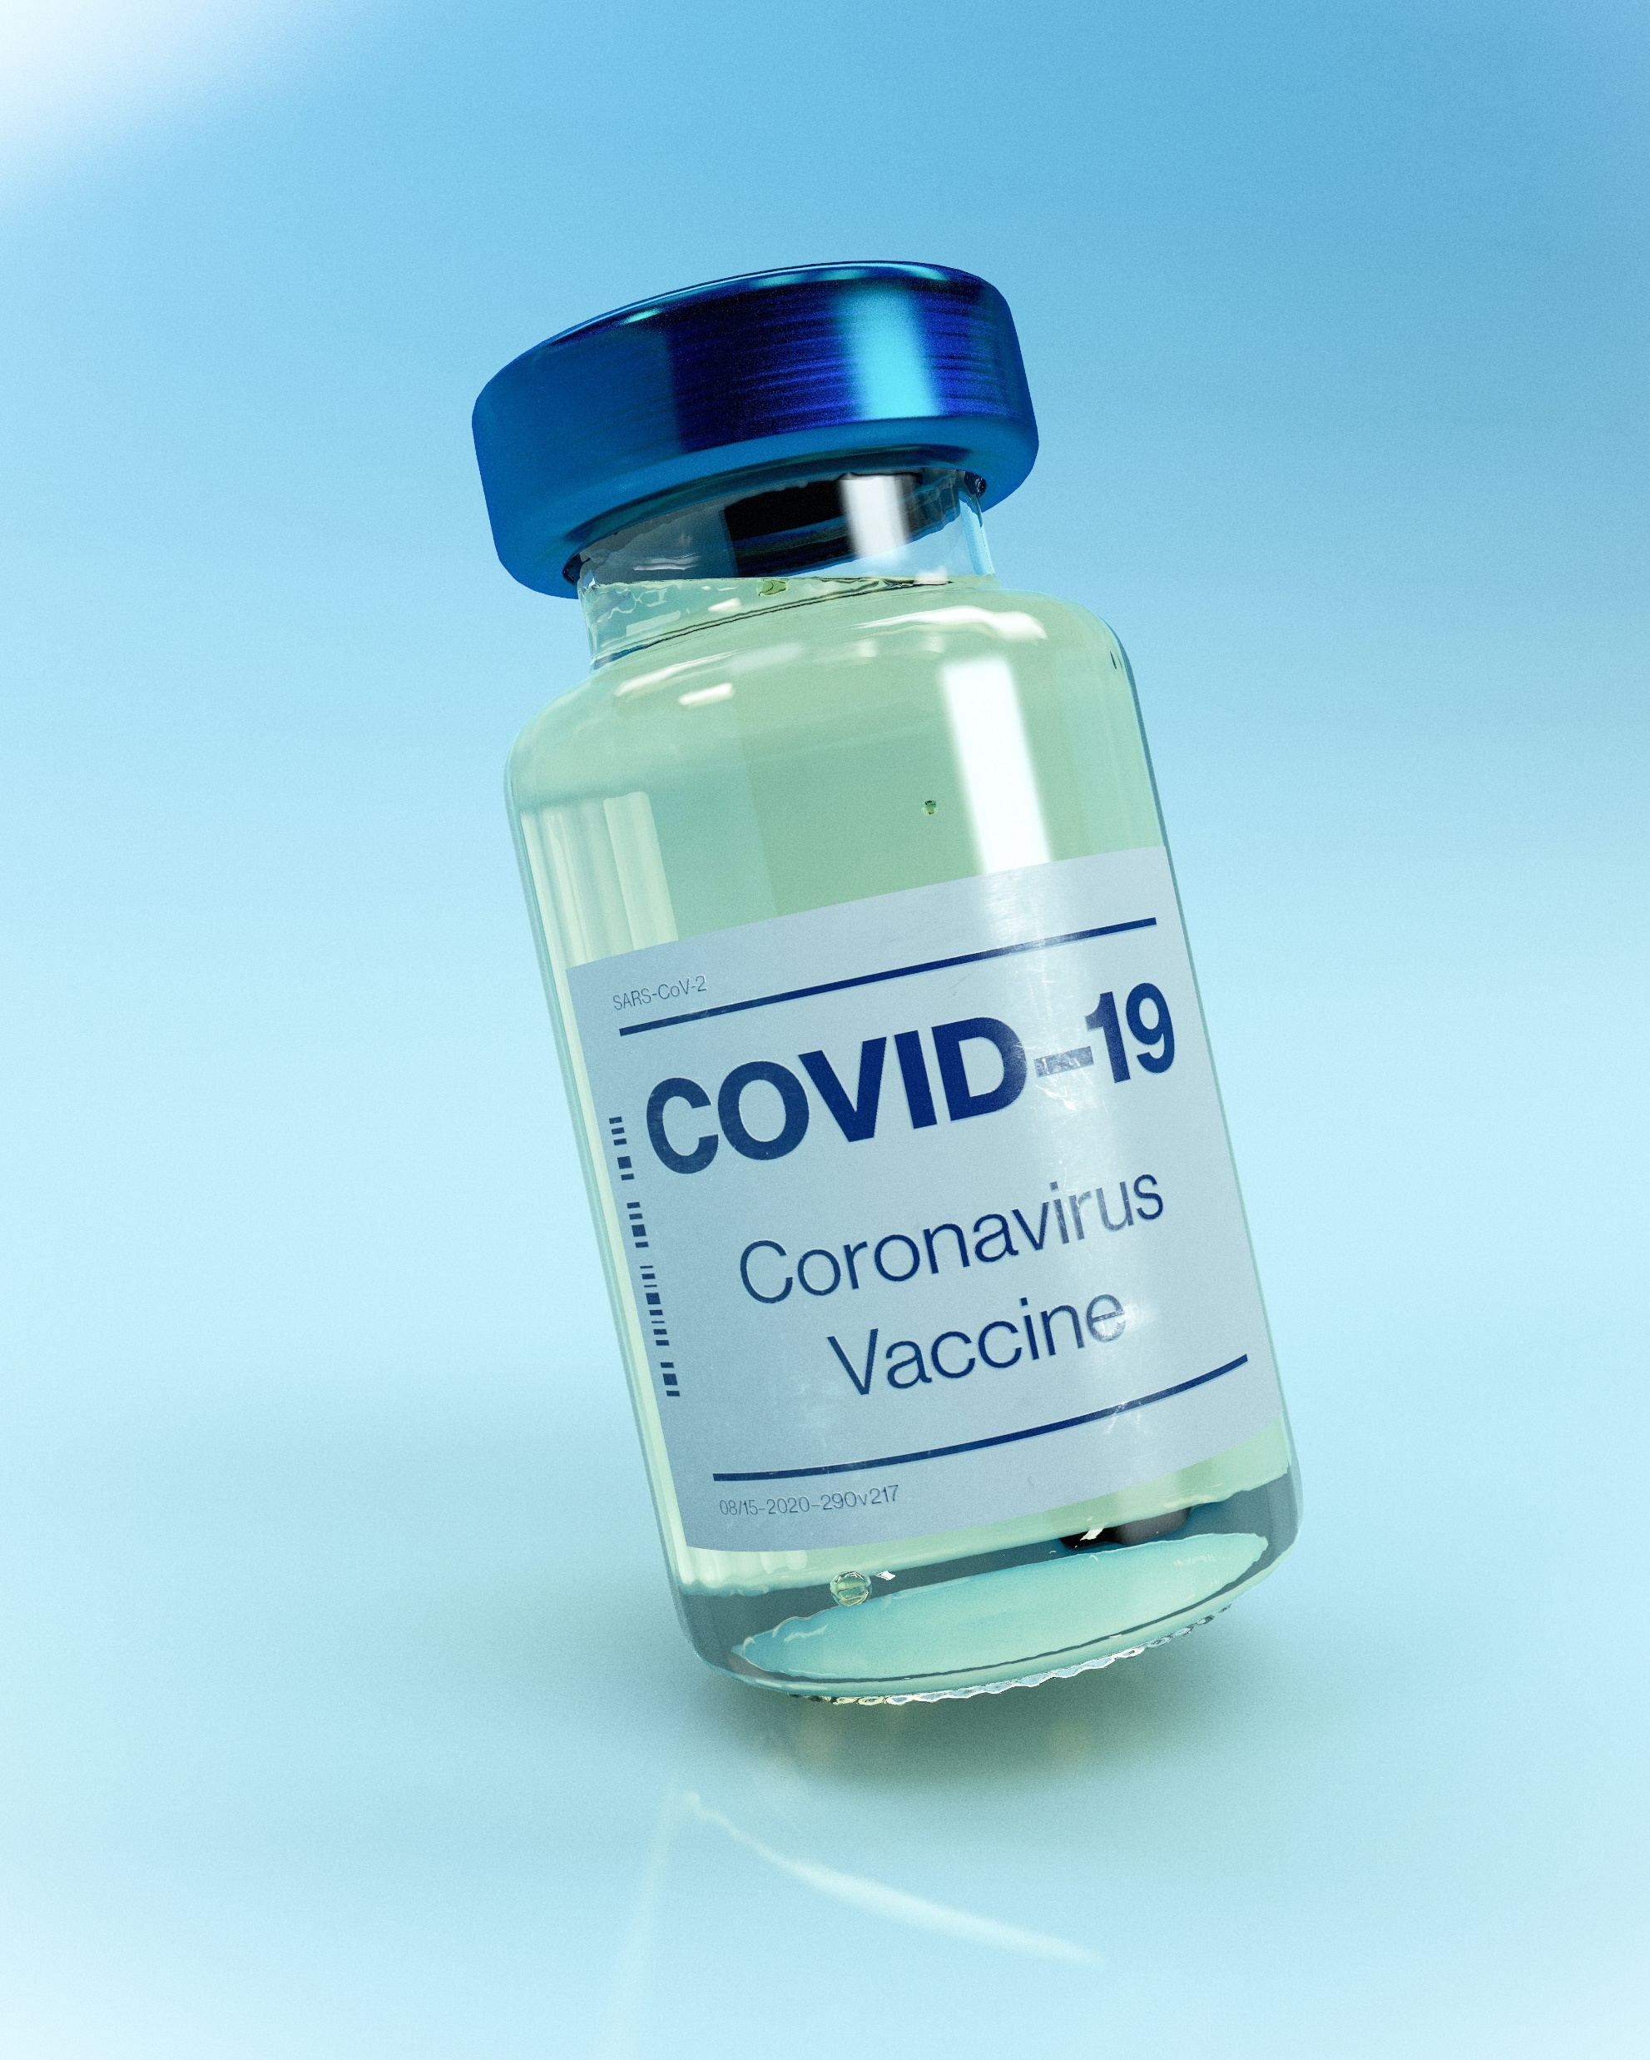
COVID-19 Covid-19 Vaccine Available
Disease
Booking Now

Slide 4
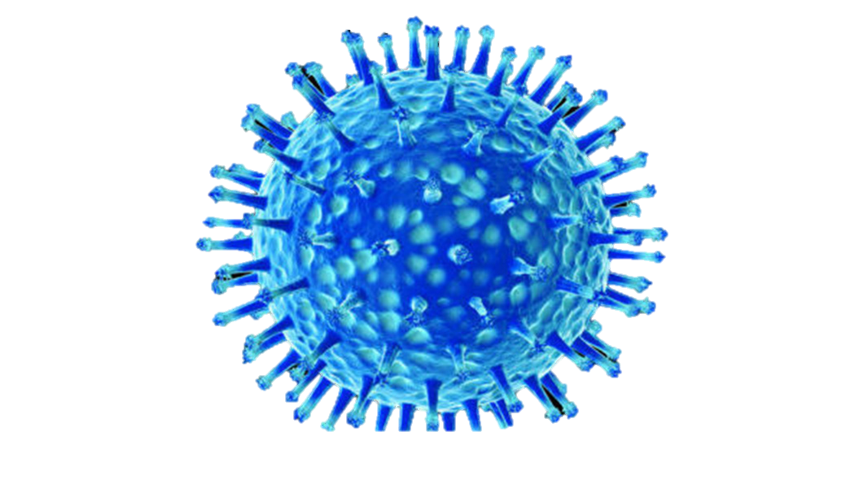
INFLUENZA VIRUS
Flu is a contagious respiratory illness caused by influenza viruses that infect the nose, throat, and sometimes the lungs.
It can cause mild to severe illness, and at times can lead to death.
The best way to prevent flu is by getting a flu vaccine each year.
Influenza (flu) can cause mild to severe illness, and at times can lead to death. Flu symptoms usually come on suddenly.
People who have flu often feel some or all of these symptoms:

Slide 5
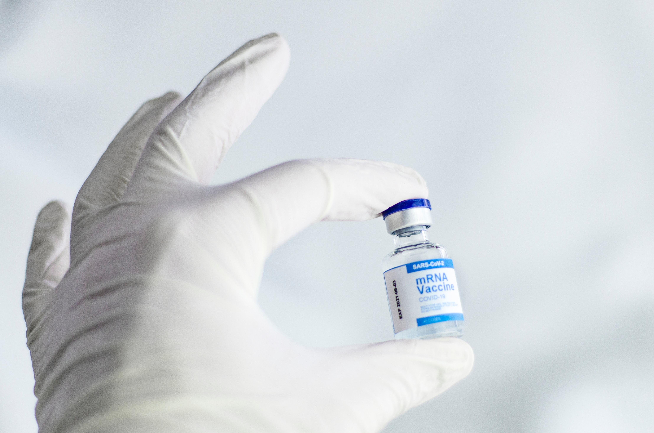
INFLUENZA VACCINE
Disease
Influenza
Vaccine
Available
Booking Now

Slide 6

EBOLA VIRUS
Ebola is a severe and often deadly disease caused
by a virus. Symptoms include fever, diarrhea,
vomiting, bleeding, and often, death.
Ebola can occur in humans and other primates
(gorillas, monkeys, and chimpanzees).
The Ebola outbreak in West Africa that began in
March 2014 was the largest hemorrhagic viral
epidemic in history. Almost 40% of the people
who developed Ebola in this outbreak died.
The virus poses a very low risk to people
in the United States.

Slide 7
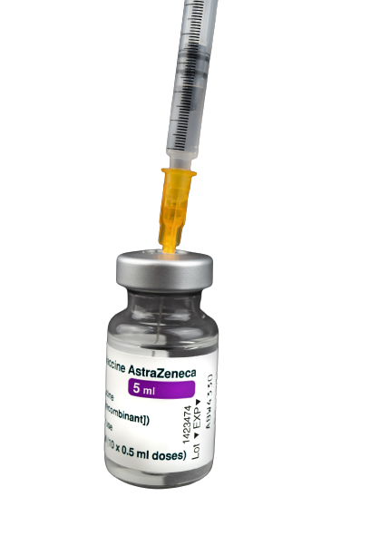
EBOLA VIRUS
Disease
Ebola
Vaccine
Available
Booking Now

Slide 8
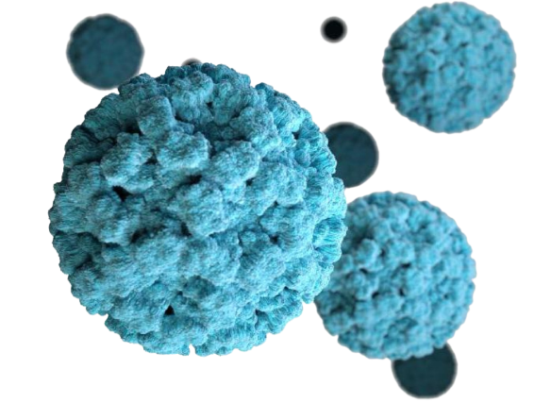
NORO VIRUS
Norovirus is a very contagious virus that causes
vomiting and diarrhea. Anyone can get infected
and sick with norovirus.
Norovirus is sometimes called the “stomach flu”
or “stomach bug”. However, norovirus illness
is not related to the flu, which is caused
by influenza virus.

Slide 9
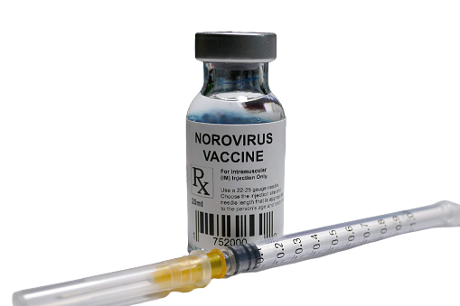
NORO VIRUS
Disease
Noro
Vaccine
Available
Booking Now

Slide 10
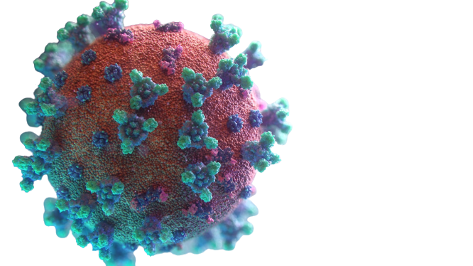
MARBURG VIRUS
Marburg virus disease (MVD) is a rare but
severe hemorrhagic fever which affects
both people and non-human primates.
MVD is caused by the Marburg virus,
a genetically unique zoonotic
(or, animal-borne) RNA virus
of the filovirus family.

Slide 11
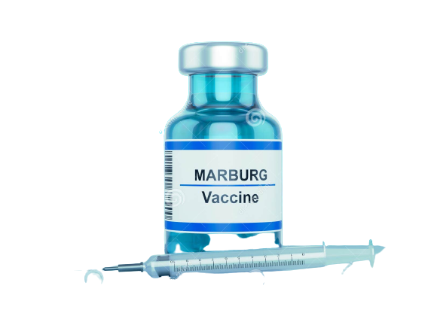
MARBURG VIRUS
Disease
Marburg
Vaccine
Available
Booking Now

Slide 12
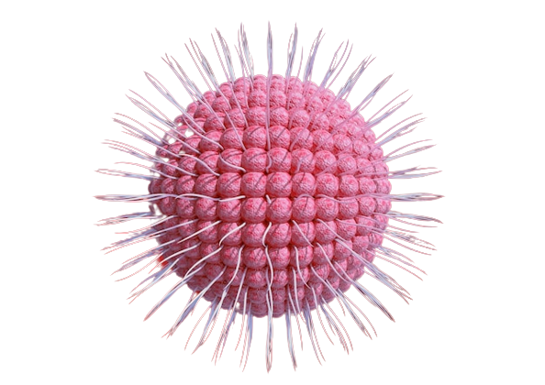
VARICELLA-ZOSTER VIRUS
Varicella (chickenpox) is an acute infectious disease.
It is caused by varicella-zoster virus (VZV),
which is a DNA virus that is a member
of the herpesvirus group.
After the primary infection, VZV stays in the body
(in the sensory nerve ganglia) as a latent infection.

Slide 13
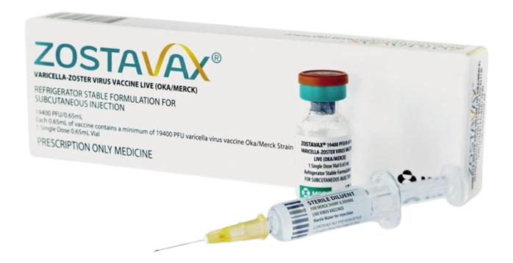
VARICELLA ZOSTER VIRUS
Disease
Zoster
Vaccine
Available
Booking Now
Notes:
Published 39 years ago.

Slide 14
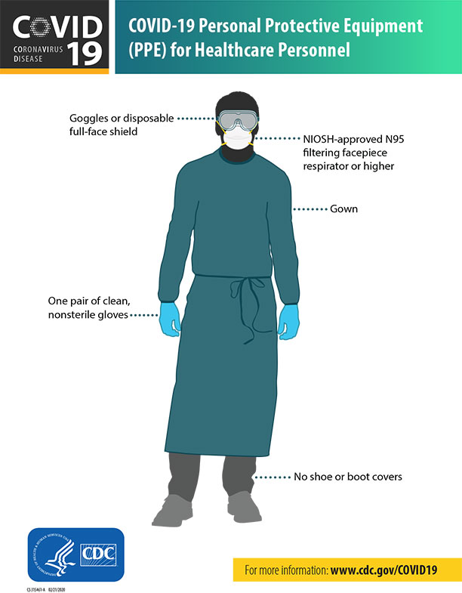
CDC recommendations
Doffing technique is even more important than donning!
Info and Videos available on CDC
Surgical Mask if no N95 and for regular exposure

Slide 15
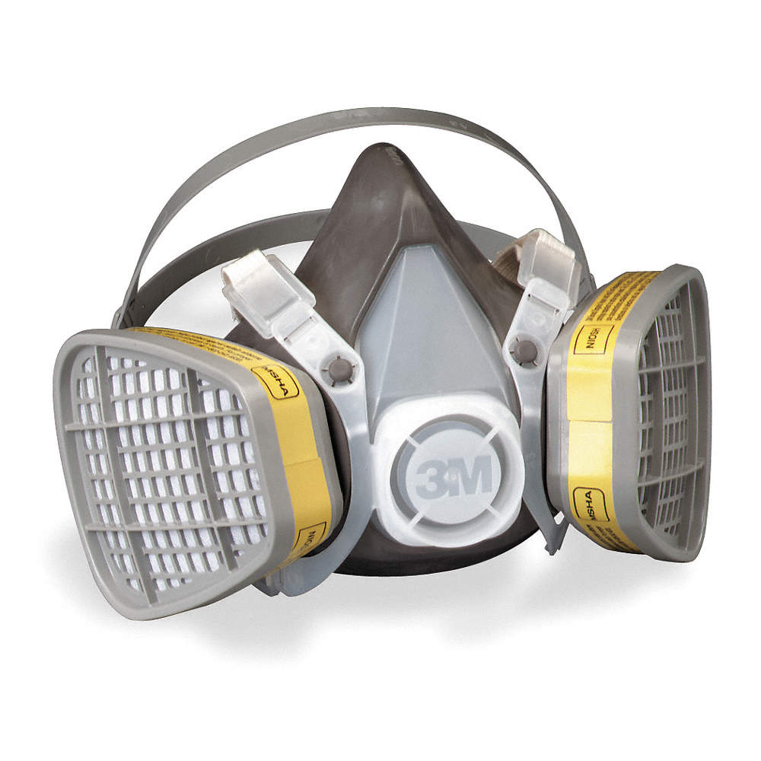
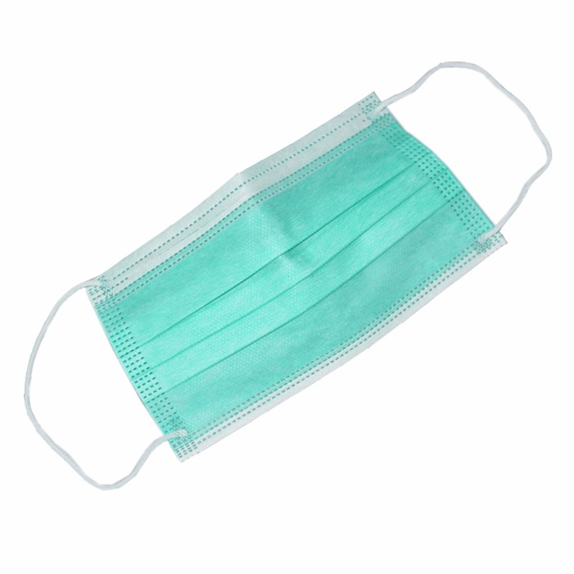
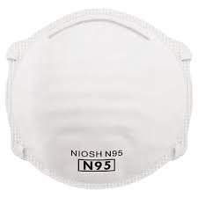
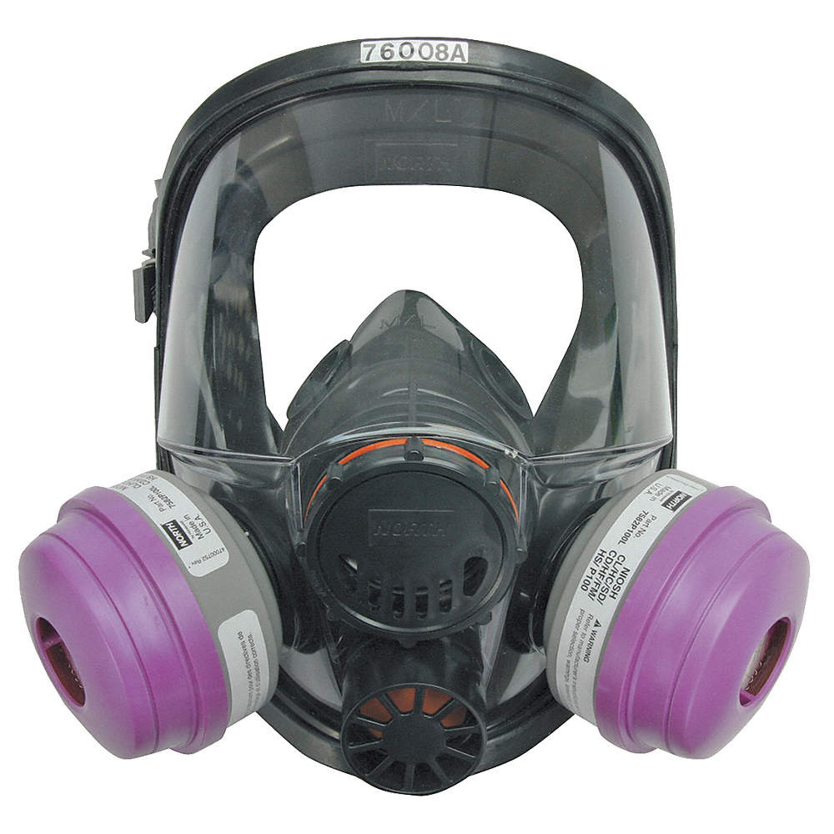

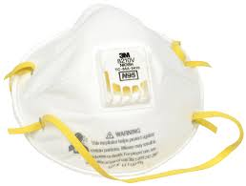

Slide 16
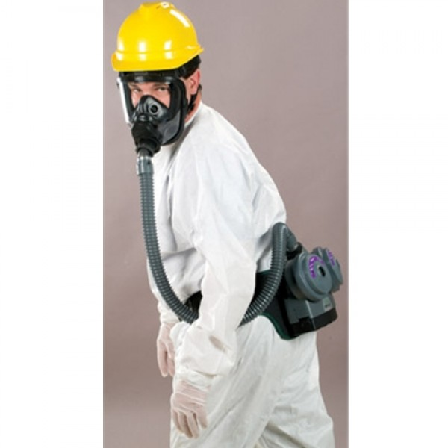
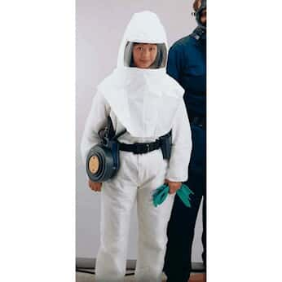
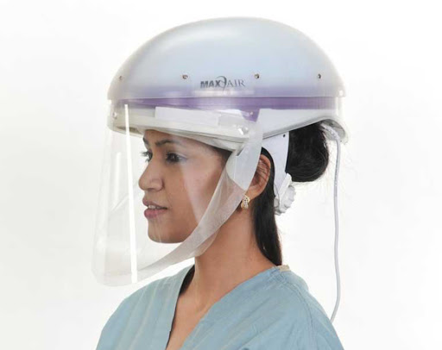

Slide 17
THANK YOU
VAX HEAVEN.COM
FOR WATCHING
CREATED BY : MR CAPTAIN TEAM

